Slide 1
Media Delivery Network Simulator
Sponsor - Ericsson Point of contact - Vladimir Katardjiev, Alvin Jude Faculty Advisor - Jia Zhang Team - Jeremy Fu, Jigar Patel, Vinay Kumar Vavili, Hao Wang
INI Project Practicum, Fall 2014

Slide 2
Project Progress Presentation
Project Overview
Project Goals
Planned tasks to deliver
Progress status (Details)
Theory/technology applied
Techniques under construction and progress
System design and development progress
Preliminary results
Demo (optional)
Health of the project progress / adjustment
Plan for the rest of project

Slide 3
Project Overview
Just to refresh the memories, the project is about building a simulator for Internet based media distribution in order to improve resource utilization and user experience.
Media Delivery Network is an overlay network over the internet.
To simulate it, we are developing a distributed system which consist of five main elements:
a management layer, with a web interface,
a “source” node capable of generating media data,
a “processing” node that would perform some media processing on the data,
a “relay” node that would consume the media data and multicast data, and
a “sink” node that would consume the data.

Slide 4
Project Goals
Design and document of data model and communication protocol to launch, capture and terminate the simulation, its agents and nodes.
Implement the four basic node types mentioned earlier
Implement the management framework and user-facing application, which forms the backbone of the simulation
Perform at least two comparative simulations, verifying the flexibility of the simulator and system
Design the system in such a manner that adding new node type is easy
Build system such that nodes can be created dynamically in different environments

Slide 5
Project Plan
Iteration 1, 9/01/2014 – 9/21/2014
Understanding requirements and exploring existing solutions to come up with initial design.
Iteration 2, 9/28/2014 – 10/6/2014
Building a simple end-to-end prototype with two nodes, source and client.
Finalize (and learn) on technologies and tools based on evaluation feedback.

Slide 6
Project Plan
Iteration 3, 10/06/2014 – 11/02/2014
Build full version of the system.
Allow the user to specify a series parameters such as CPU usage, number of nodes for each kind.
Better reporting function to tell the user what is happening in the network.
All four kinds of nodes to finish data transportation.

Slide 7
Project Plan
Iteration 4, 11/02/2014 – 12/03/2014
Testing, bug fixing
Building deployment layer - the system is deployed on at least one cloud environment.
Completing documentation as required.

Slide 8
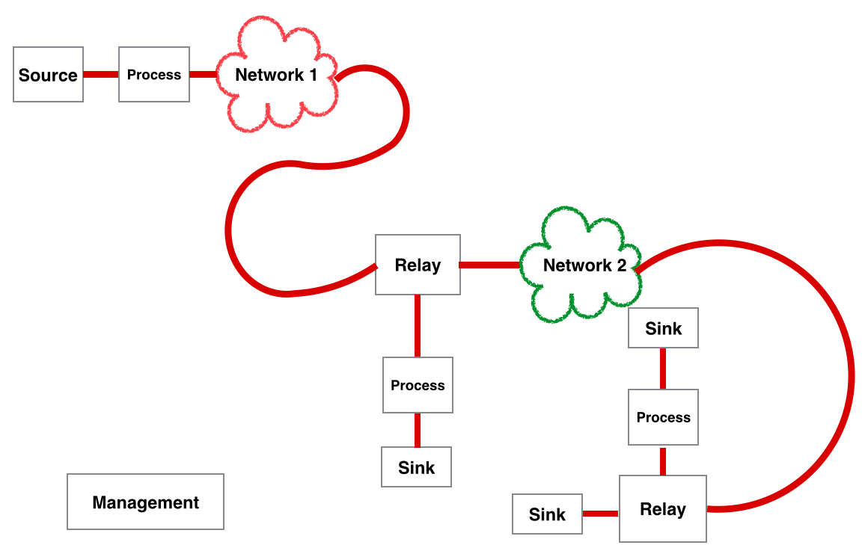
Project Status
System Design & Development Progress
High Level Topology
Overlay network over Internet
Components: Source, Processing, Relay and Sink
Management Layer: Manage the topology and coordinate streaming data

Slide 9
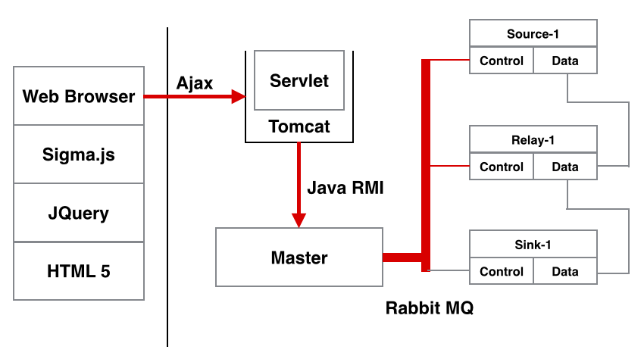
Project Status
System Design & Development Progress
Initial Design & Implementation
Front-end: HTML5, JQuery, Sigma.js
Back-end: Tomcat, Java Servlet
Inter-process call:
Ajax
Java RMI
RabbitMQ
Evaluation of Initial Design
Multiple communication mechanisms
Too many dependencies
No unified interfaces for control messages

Slide 10
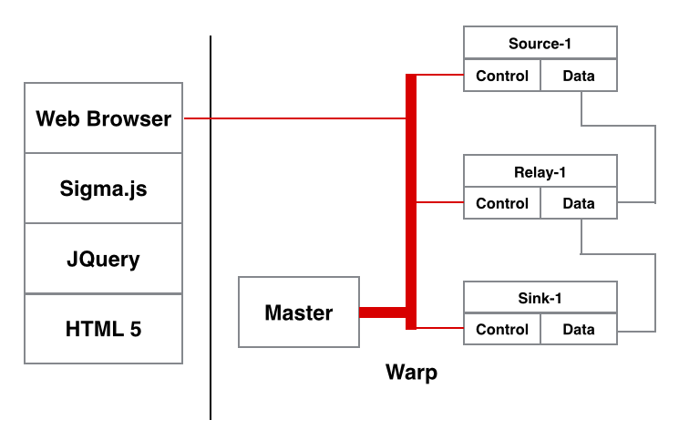
Project Status
System Design & Development Progress
Warp Design & Implementation
Front-end: HTML5, JQuery, Sigma.js
Back-end: Pure Java
Inter-process communication: Warp
Evaluation
Java implementation: Client requirements
Simplified architecture: No Java RMI, Tomcat and Servlet
RESTful architecture: Easy to manage resources
Pub-sub channel: Convenient to broadcast and manage cluster
JSON: Use JSON for control messages everywhere
Support standalone & distributed scenario: Memory & network IO

Slide 11
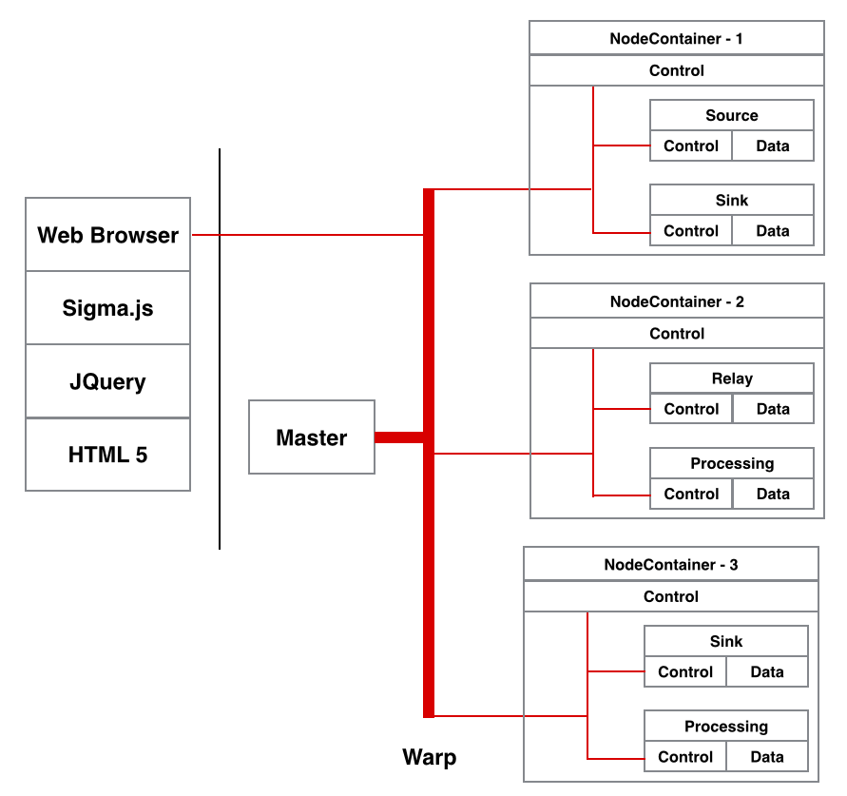
Project Status
System Design & Development Progress
Improved Extensibility:
Node Container: Instantiate functional nodes on demand
Java Reflection: Allow new added node class to be instantiated without modifying codes
Interface: Separate message bus interface from implementation

Slide 12
Project Status
System Design & Development Progress
Communication in Systems:
JSON
Simulate CPU & Memory Utilization:
“for” loop & “malloc”
Simulate end-to-end delay and packet loss
Marker in streaming data

Slide 13
Project Status - Visualization part
Solution Categories
desktop based (Graphviz, jzy3d)
web based (javascript based)
Web based libraries uses Canvas, SVG technologies to render the graph
Multiple open-source options - D3, Sigma, VivaGraph, InfoVis etc.
Based on popularity and current progress, shortlisted D3 and Sigma Reference: http://anvaka.github.io/graph-drawing-libraries/#/all
D3
Pros - most popular and has large community
Cons - Generic tool to visualize anything & has steep learning
Sigma
Pros - Built specially for graphs only and scales well for large graphs and easy to start off with
Cons - Not as popular as D3 and hence has less support
Notes:
Graphviz - renders static images and has its own language
jzy3d - desktop oriented (web support through applets) - also not specialised for graphs

Slide 14
Project Status - User Input Part
{
"SimId":"sim1",
"StreamSpecList":[
{
"StreamId":"stream123",
"DataSize":"20000000",
"BitRate":"625000",
"Flow": [
{
"NodeType":"SINK",
"NodeId":"tomato:sink1",
"UpstreamId":"orange:source1"
},
{
"NodeType":"SOURCE",
"NodeId":"orange:source1",
"UpstreamId":"NULL"
}]
}]
}
Each Simulation will contain a list of Data Streams
One data stream represents a flow of data from source to sink node (via some other nodes)
The data size specifies the amount of data to send from source to sink
Bit rate specifies the rate at which source generates data
Node Id identifies a node within a node container
UpStream Id identifies the link (Edge) between nodes
This work specification will be parsed first by Master Node and then by all other nodes in the specification

Slide 15
Project Status - User Input Part
{"SimId":"sim1",
"StreamSpecList":[
{
"StreamId":"stream123",
"DataSize":"20000000",
"BitRate":"625000",
"Flow": [
{
“NodeURI” : “abcd”
"NodeType":"SINK",
"NodeId":"tomato:sink1",
"UpstreamId":"orange:source1"
},
{
“NodeURI” : “xyz”
"NodeType":"SOURCE",
"NodeId":"orange:source1",
"UpstreamId":"NULL"
}]
}]}
Master Node will ask the Node Containers to create the nodes as asked by the user
As the nodes come up they will send their URI to the master node which will then insert them all in the Work Specification
Master will send the work specification to the nodes

Slide 16
Project Status - User Input Part
{"SimId":"sim1",
"StreamSpecList":[
{"StreamId":"stream123",
"DataSize":"20000000",
"BitRate":"625000",
"Flow": [{
“NodeURI” : “abcd”,
“IPAddress”: 1.2.3.4,
“Port”: 555,
"NodeType":"SINK",
"NodeId":"tomato:sink1",
"UpstreamId":"orange:source1"
},{
“NodeURI” : “xyz”
“IPAddress”: 1.2.3.4,
“Port”: 444,
"NodeType":"SOURCE",
"NodeId":"orange:source1",
"UpstreamId":"NULL"
}]}]}
Each node in turn will read its part and open up new socket for each data stream
Insert the port number and IP in the work specification
Then it passes the specification to the next node
Master sends the work specification to the sink node first and sink will send it to the relay, relay to processing and finally source node will receive the specification
Once source receives it, it will start sending data

Slide 17
Project Status - Technical Challenges Faced
Coming up with initial prototype with minimal dependencies
Making design extensible such that creating new types of nodes is easy
Allowing design to handle various deployment scenarios
Showing edge labels in the graph
Notes:
Solutions
using Warp
Using Abstract Node concept and Using Reflection
Concept of Node Containers and labels
Using SVG Renderer

Slide 18

Preliminary Results

Slide 19
Health of Project Progress
Milestone reached:
Topology design
Basic running demo with one source and one client node
Message bus integrated for internal communication
Interactive front end
Read user specification from script
Documentation recorded:
minutes of meeting
work specification
internal communication with advisors
Code managed:
github
Team meeting:
with advisor and client weekly
among team members
through WhatApp & Skype

Slide 20
Future project plan
Implement all kinds of Nodes including relay and processing nodes
Design and implement CPU, memory usage simulation
Provide better statistical information to end users
Refine front end to be more user friendly
Test the system
Write up comprehensive manual book to guide usage

Slide 21

Questions?

